Slide 1


YouTube:
"Python is fast enough for our site and allows us to produce maintainable features in record times, with a minimum of developers," said Cuong Do, Software Architect, YouTube.com.
Google:
"Python has been an important part of Google since the beginning, and remains so as the system grows and evolves. Today dozens of Google engineers use Python, and we're looking for more people with skills in this language." said Peter Norvig, director of search quality at Google, Inc.

Slide 2

Grammar
Python's grammar, along with its types, allow for programmers to make easy to read and are generally shorter overall programs
use of indentations as opposed to braces
no type declarations & dynamic type assignment
While most features in Python can be reproduced in other languages, it is Python’s ease of use and power that make it stand out
Because of the fact that it is interpreted and easy to read and understand complex programs are generally quickly developed

Slide 3
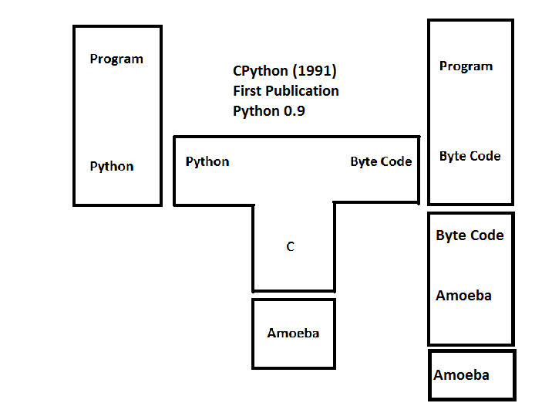
Compiler Creation
T-Diagram for CPython Interpreter
Original interpreter
Better alternatives for ABC Programming Language
Published in 1991

Slide 4
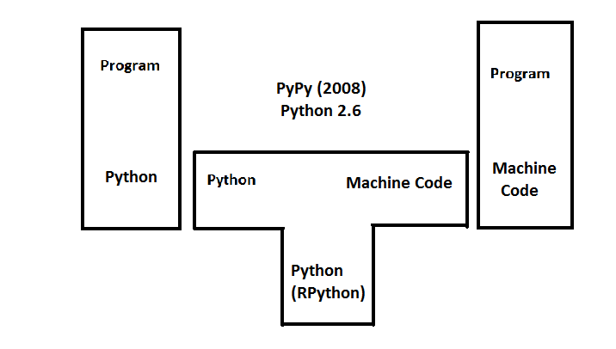
Compiler Creation
T-Diagram for PyPy Interpreter
Written in RPyhon (restricted Python)
Published in 2008
JIT (just-in-time) compiler

Slide 5
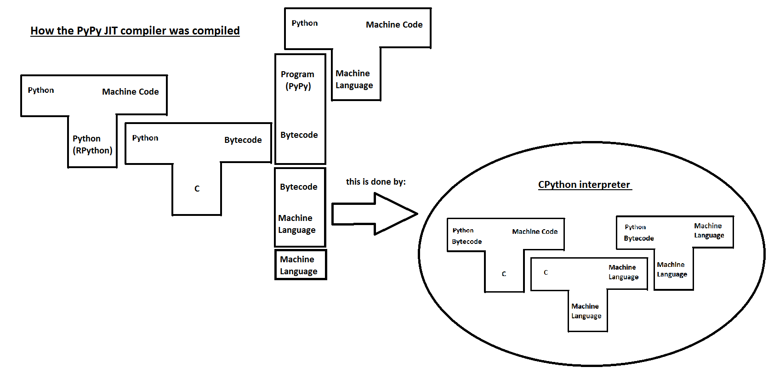
Compiler Creation

Slide 6
History
Designed by Guido van Rossum to be a scripting language on the Amoeba OS
Embeddable and extendable while remaining extremely readable
Influences from ABC, Modular 3, and C
A look at how these languages contributed to syntax, semantics, implementation techniques, pragmatics, and typing mechanisms

Slide 7
History
Type Mechanisms
Dynamically typed (i.e. type checking occurs during runtime)
This choice was influenced by ABC. However, ABC uses dynamic global variables and static local variables whereas Python uses dynamic typing for all its variables
This is also a major point of differentiation between C and Python

Slide 8
History
Syntax
Inspired by van Rossum’s first languages - ABC, Algol 60, Algol 68, C, Pascal
Keywords such as if, else, and while are borrowed from C and it shares the same naming rules for identifiers as C
To increase readability Python uses keywords instead of punctuation and has fewer syntactic constructions than many other languages

Slide 9
History
Semantics
Designed to easily be used as an extension of another language
Semantics are strongly influenced by other languages:
Strings are very similar to ABC strings but use different notation and 0-based indexing
Class mechanisms have minimal use of new syntax and semantics and were pulled from C++ and Modula-3
Like in C, class members are public while member functions are virtual
Python does not allow shorthand reference to an object member from a method, like in Modula-3
Like in Smalltalk, Python’s classes are objects

Slide 10
History
Pragmatics
Based on the pro’s and con’s of ABC
ABC was designed as a closed language intended to educate but isolate the user
van Rossum did not want Python as simplified, or locked down, as ABC
Python was designed to evolve with user input
Goal was simplicity of use without dumbing down the language

Slide 11
History
Implementation Techniques
Mostly based on ABC
Some key differences in major data type implementation
Python uses a hash table implementation rather than B-tree for lists
Python uses two integer types
Some influence from functional programming languages such as Lisp and Scheme, mostly due to user demand (and creation)
map(), filter(), and reduce() were brought in in 1994

Slide 12
Types
Python is NOT a strongly typed language
Python is dynamically typed
Therefore type inference is very important feature for Python, but there are some difficulties in actually implementing this
Primarily two algorithms used for type inference
Cartesian Product -----> (best suited for object oriented)
Hindley-Milner -----> (best suited for functional)
Python is object oriented and the Cartesian Product would seem best suited for type inference; however, the dynamic type declarations make this difficult as all control info needed may not be available at compile time
Notes:
-Python is not strongly typed
- And in fact it is dynamically typed
-This means that type inference is very important in

Slide 13
Types
Several alternate implementations have been proposed for python, specifically to address some of the problems of dynamic typing
Compiler Based Implementations
Psyco
just-in-time (JIT) compiler which tries to detect ints and strings that are consistent from compile-time to run-time
Using this information, infers locally deﬁned ints and strings directly and does not modify any other types.

Slide 14
Types
Starkiller
Uses a modified version of the Cartesian Product Algorithm
Type inferencer and compiler: Python Programs ===> C++ Programs
Inferencer supports the majority of Python language except for dynamic code insertion features such as eval and dynamic module loading.
Starkiller’s compiler on the other-hand is at a very early stage of development; it currently lags far behind the type inferencer

Slide 15
Types
Tool/Debugger Based Implementation
PyCharm (2.7 or newer)
Python IDE collects type information at runtime, use it to improve code completion suggestions, code insight, and quick documentation popups

Slide 16
Types
Aggressive Type Inference (ATI)
Assumes that in general people do not write dynamically-typed programs even though it is possible.
Programs must be written in such a way that ATI can infer exact types.
Input Python program is scanned and parsed. (No semantic checks are performed)
All information relevant distilled into summary and saved.
The summary information is repeatedly examined in order to propagate type information.

Slide 17
Types
Benefits of Type Inference
Used to check that illegal operations do not occur between disparate values
Type information can also be used to improve performance, such as identifying integers and performing integral math at the assembly level
Gives beneﬁts of type information at compile-time without the programming overhead
Allow for early error detection making code optimization and certification easier
Some cons include:
Very difficult to implement an accurate and robust type inference for Python and requires a high level of sophistication if the language is to remain unchanged
Critics believe that the benefits of its dynamic type assignment are not worth the difficulty and compromises the flexibility of Python as a programming language

Slide 18
Summary
Python’s grammar because of its high level of abstraction, relative simplicity, and features such as dynamic type assignment allow its programmers to quickly develop complex programs
Python normally uses an interpreter written in C to interpret the bytecode that results from a python program. Other implementations, such as PyPy use a custom interpreter or compiler to run Python programs.
Python’s history takes many pieces from imperative languages such as C, Algol 68, and ABC. It has become a very popular language designed to be extendable, embeddable and evolvable, while still being very easy to read and write.
Some new implementations have been developed to address Python’s dynamic typing. These include compiler and debugger based implementations of the solution.

Slide 19
Questions?

